Slide 1
ATIEL & UEIL Sustainability A collaborative approach
Gemma Stephenson
UEIL

Slide 2
Overview
Why collaboration is essential
What collaboration can achieve

Slide 3
Collaboration

Slide 4


Two individual associations…
ATIEL is the Technical Association of the European Lubricants Industry representing the combined knowledge and experience of leading European and international engine oil manufacturers and marketers
UEIL represents the interests of the lubricants industry in Europe, covering the whole lubricants’ value chain, from manufacturing and distribution to recycling

Slide 5

…forming a more powerful voice
Feb 2023:
ATIEL and UEIL signed a Memorandum of Understanding to form a Joint Sustainability Committee
Jun 2024:
ATIEL & UEIL Sustainability Committee officially operates as one joint team
The only way forward is collaboration!
Jan 2024:
ATIEL and UEIL agreed on Terms of References for a Joint Sustainability Committee
Notes:
“ATIEL and UEIL will join forces to speak with a single voice on issues of common interest.
In the short term, both associations will invite each other to their respective committees related to HSE and sustainability…
In the longer term, both associations will look to set up joint sustainability and joint HSE committees….
Joint positions by ATIEL and UEIL will be prepared by the two respective committees…”

Slide 6


…with one shared mission and vision
Vision
We envision a world where businesses of all sizes recognise the value of their environmental, social, and organizational impacts and look for opportunities to enhance them.
Mission
We strive to provide our stakeholders with reliable information to make informed decisions in-line with responsible environmental, social and organizational governance standards, regulations and directives, and to empower members with knowledge and tools to navigate the transition to a more sustainable future.
We leverage the work of the Sustainability Committee to reach out and influence EU-Brussels stakeholders about the industries sustainability initiatives.
Notes:
Check up to date

Slide 7




…tackling industry challenges together
Carbon Footprint
Downstream use
Circularity
Communications

Slide 8
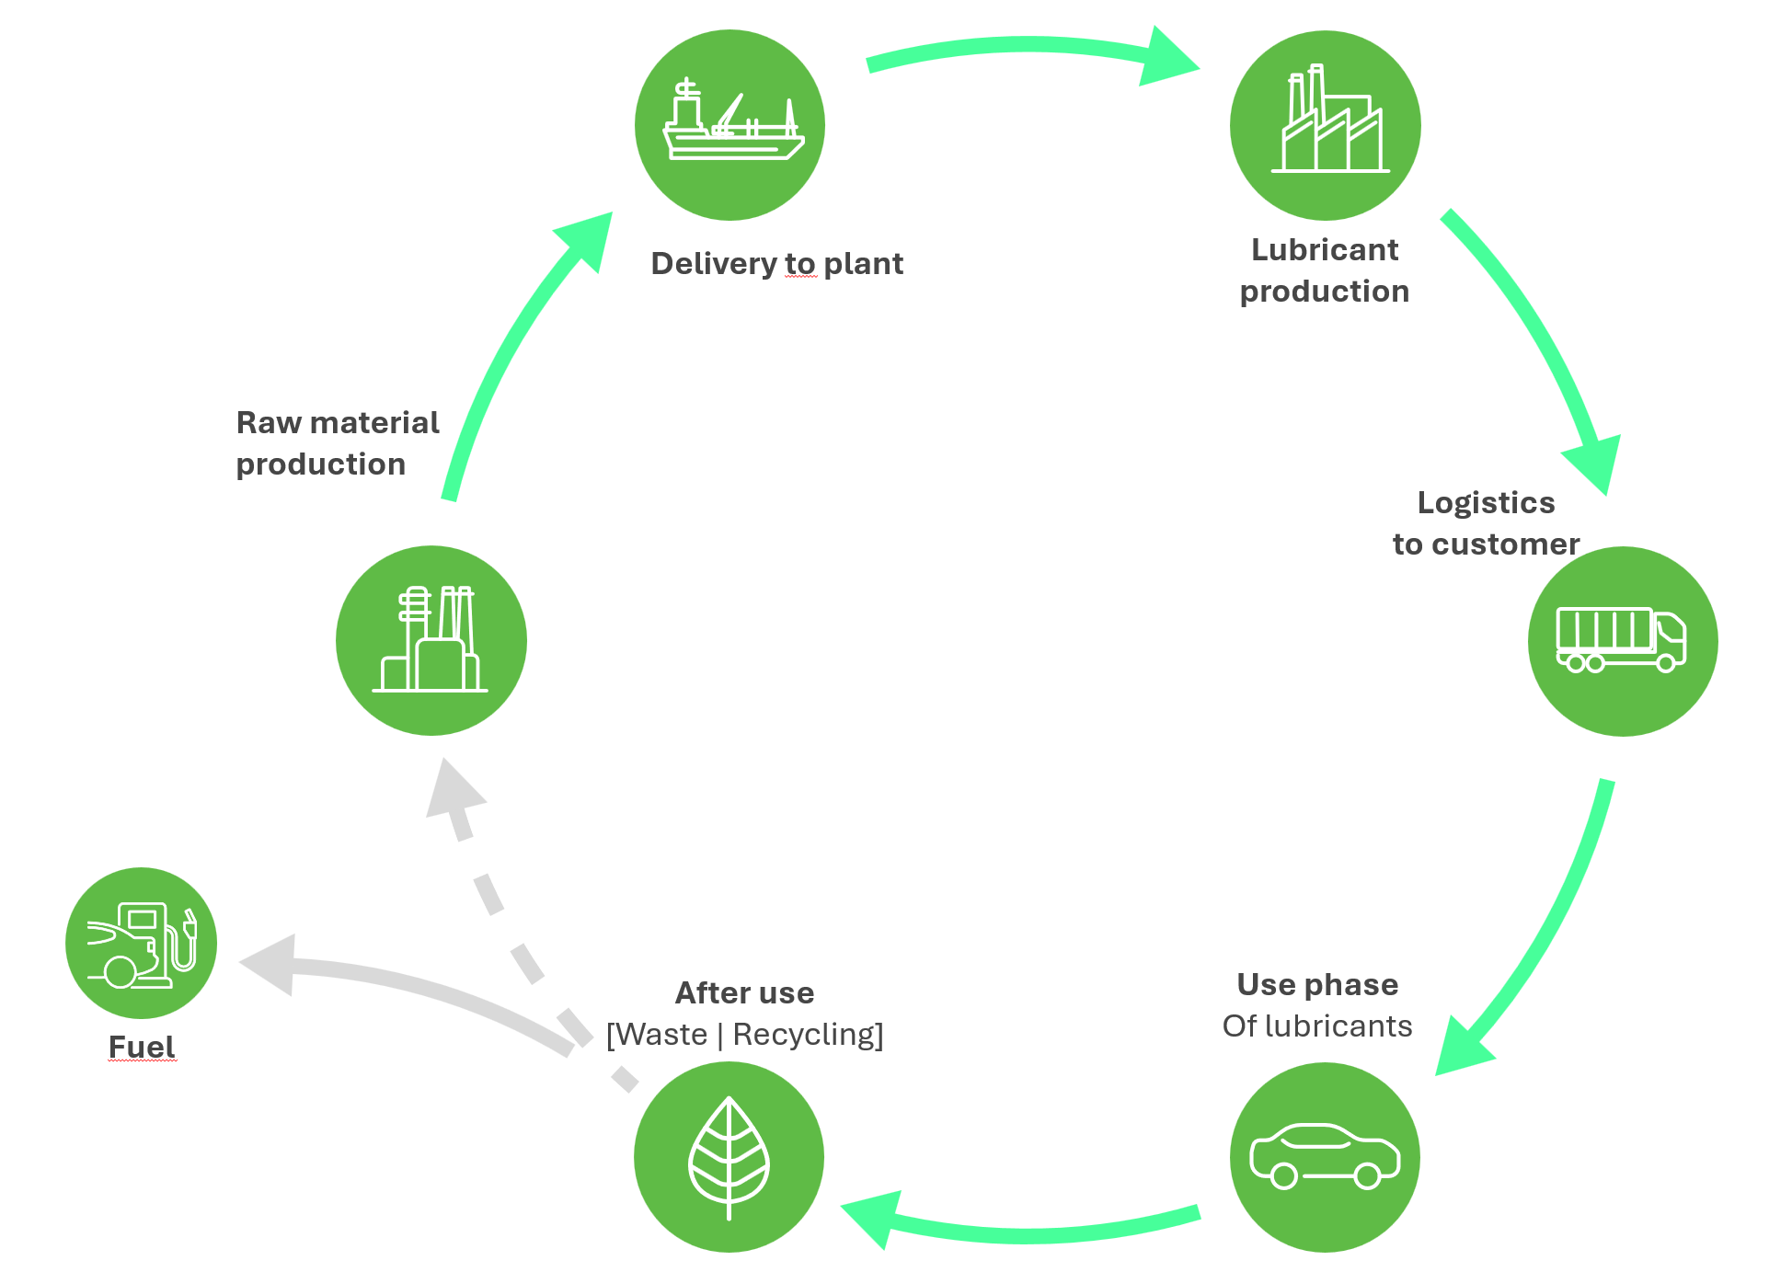
ATIEL & UEIL Joint Sustainability Committee Full lifecycle view
Carbon Footprint Working Group
Circular Materials
Working Group
Downstream
Working Group

Slide 9
ATIEL & UEIL Joint Sustainability Committee from March 2025
Carbon Footprint Working Group
Herrmann/Kettunen
Downstream
Working Group
van der List/Booth
ATIEL & UEIL
Joint Sustainability Committee
Garb/Kettunen
Communications Working Group
Swanson-Parbäck/Stephenson
Circular Materials
Working Group
Southby/Masucci

Slide 10
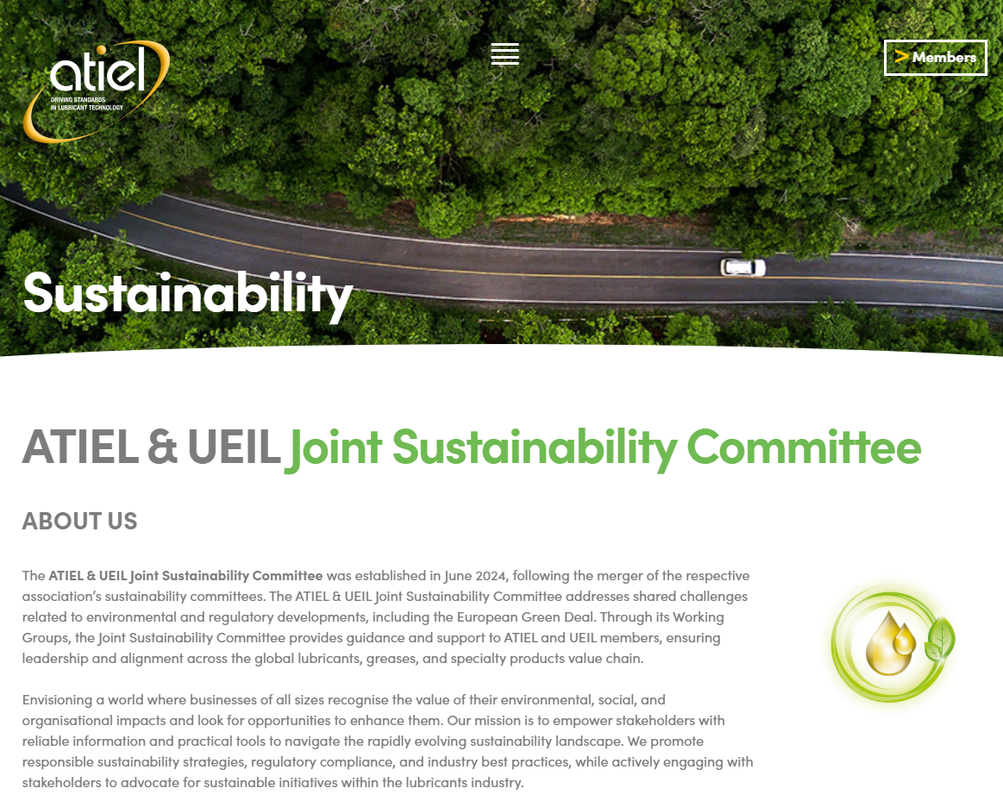
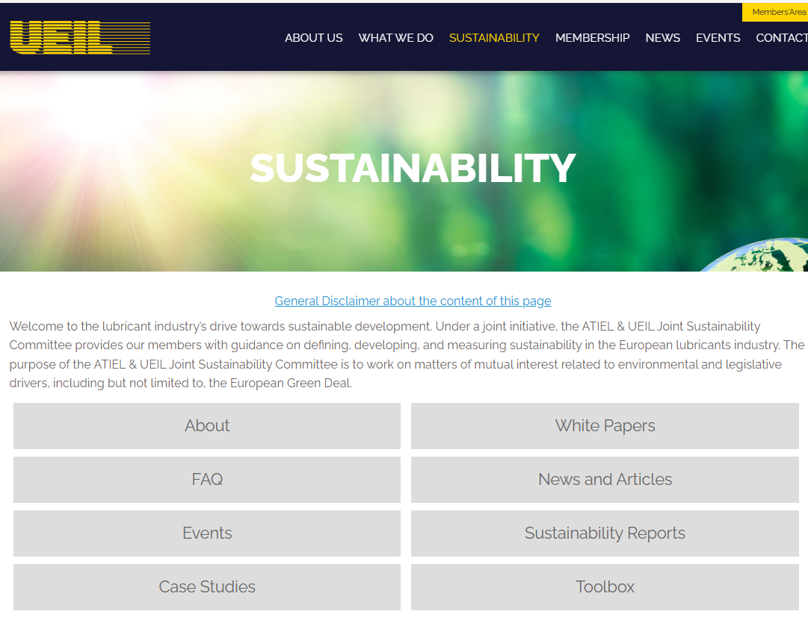
Website and digital
Access to resources

Slide 11
Carbon Footprint Working Group

Slide 12
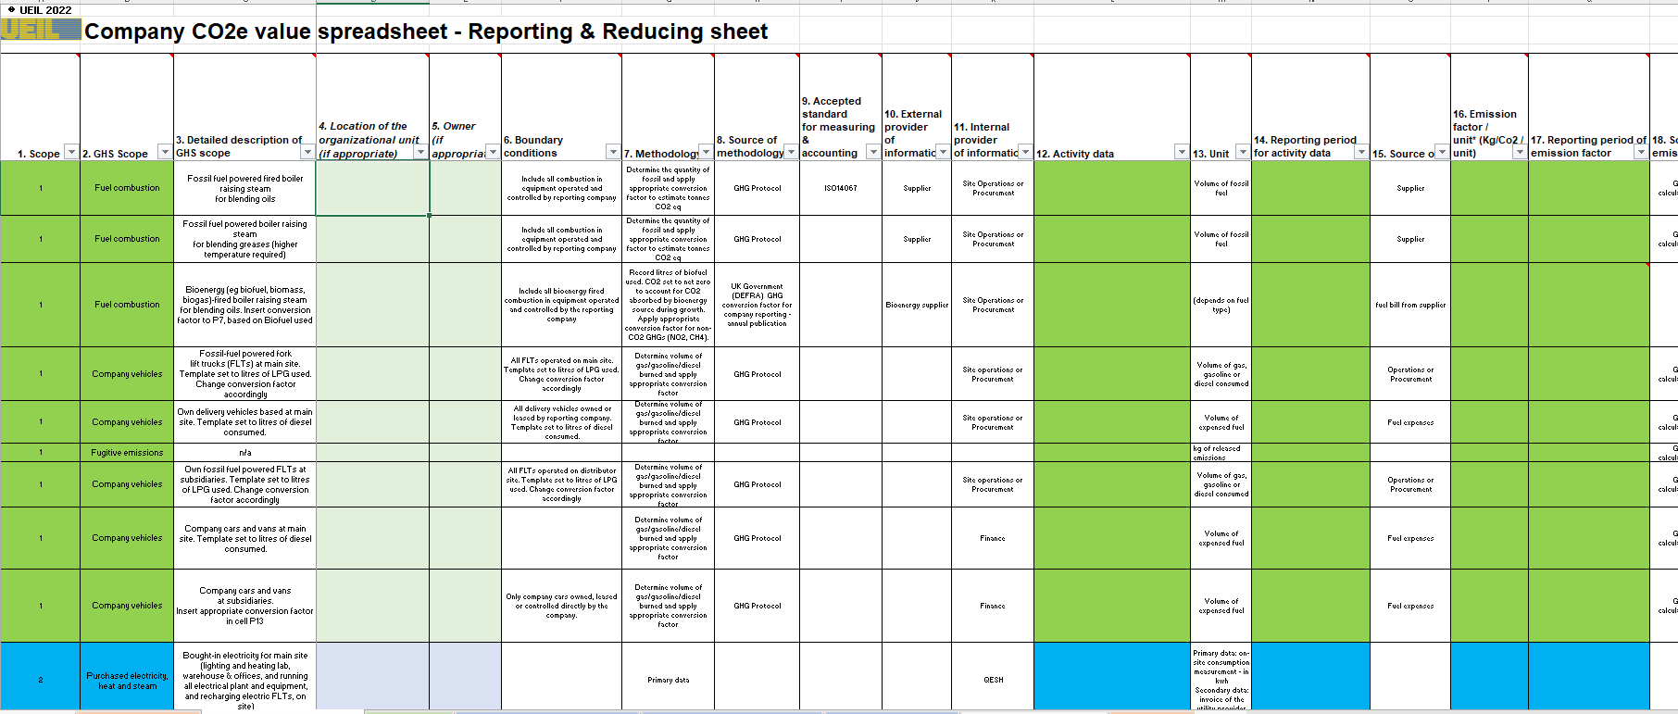
Corporate carbon footprint
Company CO2e Value Guideline
Intention is to support UEIL and other companies to measure and account for, and reduce, the carbon footprint of their activities (corporate carbon footprint) and products (PCF)
Notes:
Company CO2e Value Guideline
The intention of the below document is to start supporting UEIL and other lubricant companies in their steps to measure and account for, and reduce, the carbon footprint of their activities (corporate carbon footprint) and products (product carbon footprint).
Another aim is to start a journey within the community and unfreeze companies who have not engaged in this topic yet or miss the knowledge of doing so.
The document contains the ‘Lubricants Charter’ of a fictitious company, an example and template of CO2e spreadsheet and guideline to the template. The document is reviewed on a quarterly basis.

Slide 13
Product Carbon Footprint of Lubricants
WHY
Regulators, Consumers and Equipment Manufacturers require the submission of PCF for products sold. Our products’ PCF becomes part of our customers’ PCF.
ISO 14067 is not precise enough to be able to assure compatibility of PCF-calculations in a specific sector like the lubricants industry
There is a need for harmonization and clear definition how to calculate and REPORT the PCF for lubricants
Parallel activities in the wider industry
“Together for Sustainability” published a PCF-methodology for chemicals – very detailed but not fully applicable for the lubricants sector since different decisions are required for manufacturing lubricants and greases compared to chemicals
API has published Technical Report 1533 – leaving many options
Notes:
To manage these efforts in the lubricants industry, we need to assess the product carbon footprint, or PCF, of lubricants in a concise way which is meaningful across the value chain.
This is important for regulators, consumers and equipment manufacturers because our products’ PCF becomes part of our customers’ PCF.
ISO 14067 outlines well the basis for product carbon footprint calculations but it is covering all sectors from toys to chewing gum or tools, so it is naturally quite generic.
If I ask an LCA practitioner to calculate the PCF for a lubricant with it, I can get several different results because it is not specific enough for a specific sector like lubricants.
So there is a need for clear definition how to calculate and report the PCF for lubricants.
This challenge has then motivated industries to initiate workgroups to fill the gap.
Activities in wider industry include:
“Together for Sustainability” which has published a Product Carbon Footprint Guideline for the Chemical Industry – which is very detailed but not fully applicable in the lubricants sector.
And API which has published a technical report on Lubricants LCA and Carbon Footprinting—Methodology and Best Practice, which is leaving many options still.

Slide 14




PCF – Relevance for our industry Why are methodologies needed and how do they contribute to transparency ?
No methodology
Even with greatest care applied, results cannot be compared, thus might be meaningless for downstream partners in the value chain
Moreover, results without transparency how they were calculated are meaningless at all
ISO 14067
Gives a framework in which to operate
Defines mandatory elements to consider
Defines minimum requirements for reporting
BUT: is not a detailed How-to-guide; requires manifold decisions to be taken leading to non-comparable results
Sector-specific methodology based on ISO14067
Addresses all requirements of ISO14067
Contains guidance for methdological choices which ISO left open to decide
Defines categories for data sources and quality indicators
Basis for harmonizing PCF-results if calculated with similar and certified methodologies
Product Category Rule based on ISO14067
Addresses all requirements of ISO14067
Mandates methodological choices and data sources for a specific product group
Required for complex processes/sectors for which a methodology would still leave open too many options → for example the refinery sector could benefit from it
Notes:
Why are methodologies needed and how do they contribute to transparency?
PCF results reported without a methodology are simply meaningless without transparency how they were calculated, what is included and what not, and what the results represent.
As said, ISO 14067 defines mandatory elements to consider and minimum requirements for reporting results but it is not a detailed how-to guide leaving practitioner manifold decisions to be taken leading to various result options.
A sector-specific methodology based on ISO14067 addresses all the requirements of ISO but also contains guidance for methodological choices which ISO left open.
It also defines categories for data sources and quality indicators.
This is the basis for harmonizing PCF results.
Finally there is a Product Category Rule, which mandates methodological choices and data sources for a specific product group. Less decicions needed leads to more comparable PCF results in the end.
Product category rules would be epecially beneficial for complex processes or sectors such as refinery sector.
[Click]
So, we decided that for harmonizing the PCF calculations in the lubricants industry we need to develop an explicit sector specific methodology based on ISO 14067 standard

Slide 15
Joint UEIL/ATIEL – PCF – Task Force
HOW
UEIL and ATIEL enable for harmonization and clear definition how to calculate the PCF for lubricants, compatible with TfS and API:
Chemical industry (TfS): methodology has been endorsed by ATC representing the additive suppliers
API has published a Technical Report which is endorsed by the US base oil suppliers
UEIL/ATIEL PCF-Task Force started Jan 2023
6 months - 1 working group – 10 members (ATIEL, ELGI, GEIR, UEIL, UNITI/VSI, TfS) – 1 consultant – 4 personal meetings - 17 online meetings to develop the draft ready for consultation phase June/July 2023 – feedback considered from many associations
WHAT
UEIL/ATIEL-Methodology Rev. 0 published Oct 6th 2023
TÜV-Rheinland 3rd party review led to Rev. 1, published Nov 30th 2023
Notes:
To make this happen, ATIEL and UEIL formed a specific PCF task force consisting of 10 industry experts representing different organizations in the European lubricants industry.
The Task force hired a skillful consultant Carbon Minds to steer the process and started working on our PCF methodology in January last year.
I’d like to highlight that the work targeted to be compatible with, and endorsing, the forementioned guidelines from TfS and API.
And 6 months later, after 4 in person all day workshops and 17 online meetings we held in hand a draft which was sent to the relevant industry work groups across the globe for feedback.
Finally, the methodology was published late last year and got validated by TÜV Rheinland
I will now hand over to Markus to dive deeper to the content of this document.

Slide 16


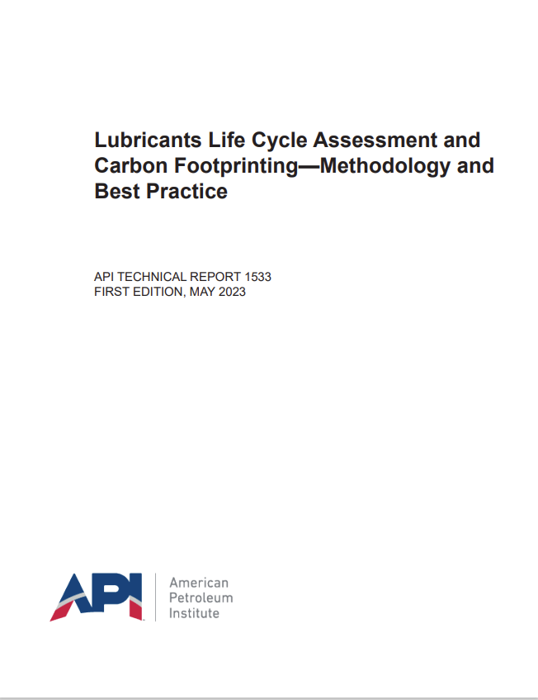
Product Carbon Footprint and Life Cycle Assessment
Product Carbon Footprint methodology for the Lubricants Industry (UEIL/ATIEL)
Product Carbon Footprint Guideline for the Chemical Industry (TfS)
Lubricants Life Cycle Assessment and Carbon Footprinting – Methodology and Best Practice (API)
Product Carbon Footprint methodologies of downstream industry sectors using lubricants
Cradle to gate
Cradle to gate
Cradle to grave
Notes:
“Together for Sustainability” published a detailed PCF-methodology for chemicals – not fully applicable for the lubricants sector since different decisions are required for manufacturing lubricants and greases
API has published Technical Report 1533

Slide 17

Product Carbon Footprint and Life Cycle Assessment
Industry-first certification of the methodology by
TÜV Rheinland Energy GmbH
A significant milestone in the global effort to standardise carbon footprint calculations for lubricants, fluids, and greases, reinforcing the methodology’s credibility and trustworthiness across the industry
Looking forward we will continually keep the methodology up to date with international bodies and regulations

Slide 18
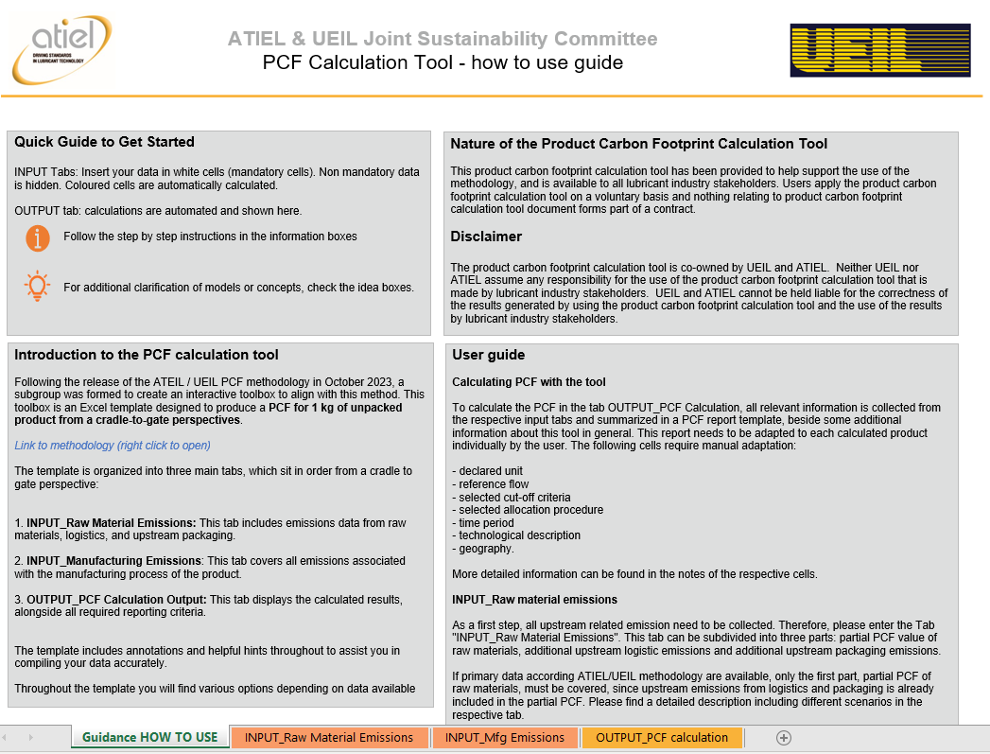
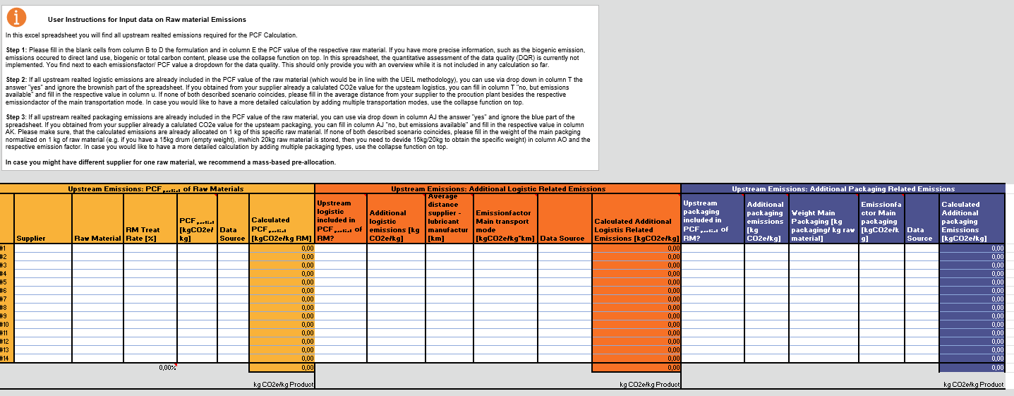
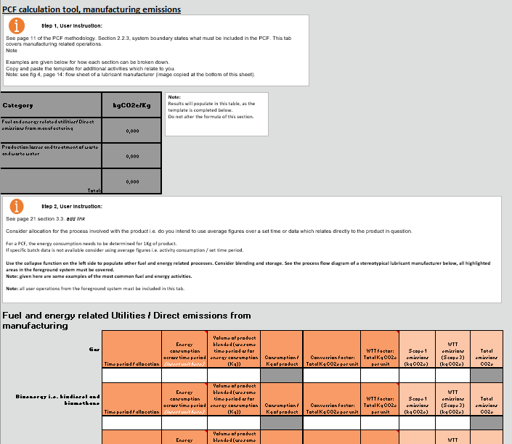
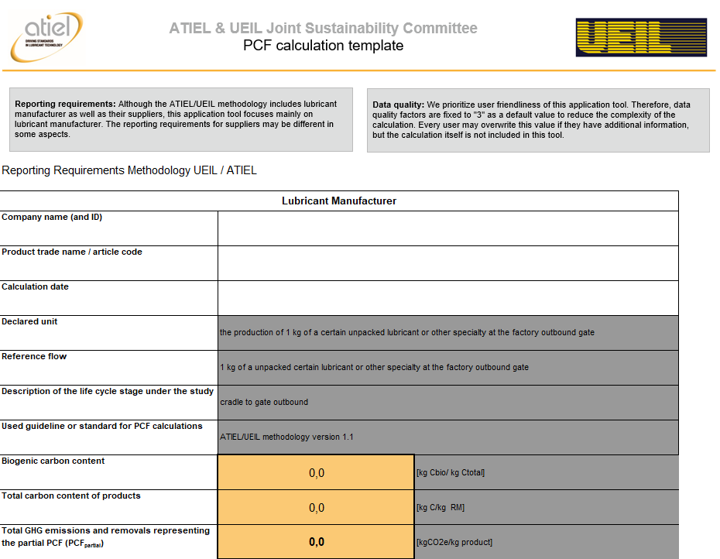
PCF Calculation Tool overview
Key Features
Why Use It?
User-friendly guidance for smooth implementation
Input tabs for emissions from raw materials and manufacturing
Clear output tab for transparent PCF results.
Transparency: Allows you to apply the certified sector-specific PCF methodology
Consistency: Enables alignment with regulatory requirements and industry standards
Market Edge: Highlights your commitment to sustainability.
Notes:
Another one of the main outcomes from this joint work was the development of a PCF calculation tool.
If you do not have it yet, you can open it from the ATIEL or UEIL websites under sustainability.

Slide 19
Downstream Working Group

Slide 20



White Papers on Downstream Aspects
White Paper updates
Released
2021
2022
Basics of Sustainability Reporting
Link to: White Paper
Understanding the product carbon footprint of lubricants
Link to: White Paper
2023
2022
EU Green Deal
Link to: White Paper
Understanding the product carbon handprint of lubricants
Link to: White Paper
2022
Key Performance Indicators of Sustainability Reporting
Link to: White Paper
2022
Circular Economy
Link to: White Paper
2023
2024
1.2
Scope 1-2-3 Emissions
Link to: White Paper
Avoided Emissions
Objective: inform and clarify avoided emissions guidelines.

Slide 21
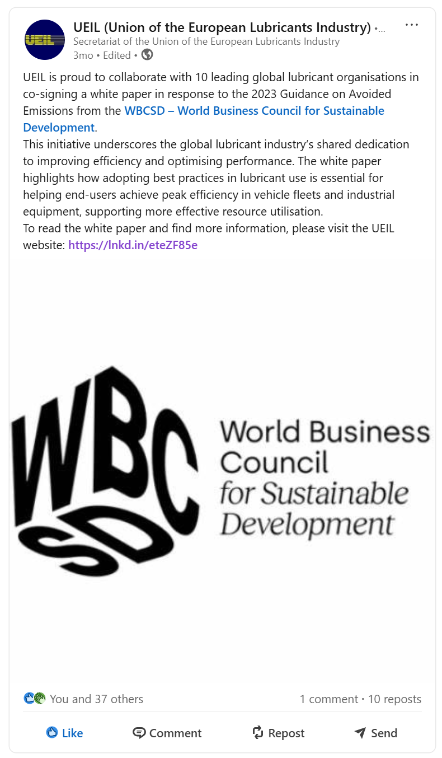
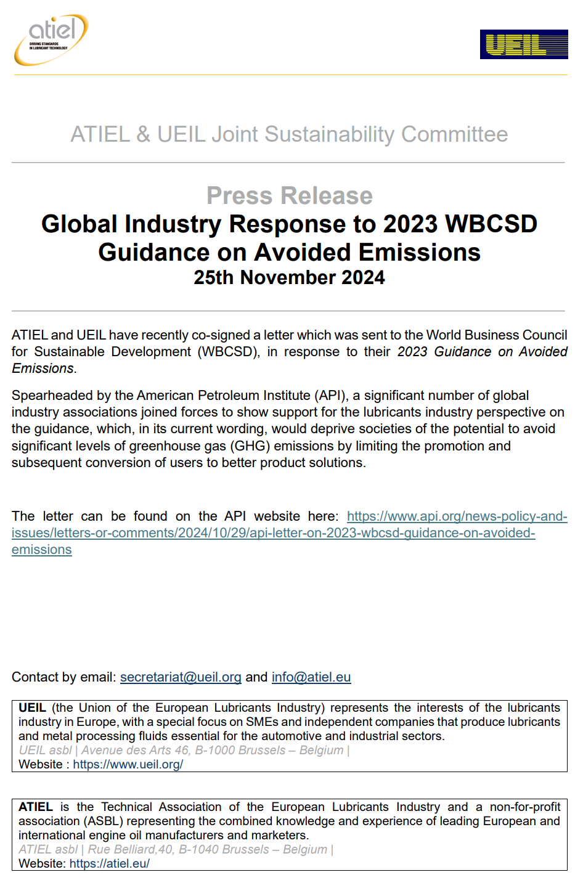
Lubricants and Greases Avoided Emissions
Key points from Technical Document WBCSD:
Fossil products may help decarbonize but risk lock-in.
Use only if no low-emission alternatives, with oversight and transition plan.
Avoided emissions don’t count for phased-out tech.
Separate approach needed for phase-down.
industry
response
Key points from industry Response: Open Consultation
Support for broader scope in avoided emissions guidelines.
Lubricants play a role in decarbonization (e.g., in EVs).
Improve criteria:
Add price comparability.
Remove impractical monitoring of end-use.
Include re-refined and bio-based oils.
Recognize efficiency gains in fossil-dependent sectors.
Status and next steps:
Ongoing collaboration with 11 global associations on WBCSD response.
ATIEL & UEIL JSC / Downstream WG to define own position on Avoided Emissions.
Continue promoting lubricants' role in sustainability.

Slide 22
Downstream White Paper / Document Releases
White Papers / Documents released
Released
Planned
2021
2022
Basics of Sustainability Reporting
Link to: White Paper
Understanding the product carbon footprint of lubricants
Link to: White Paper
TODAY
2023
Lubricant End-of-Life
Objective: support circularity, sharing sustainable best practices. Encourage to leverage insights to enhance lubricant end-of-life program.
2022
EU Green Deal
Link to: White Paper
Understanding the product carbon handprint of lubricants
Link to: White Paper
2025
Automotive lubricants
Objective: inform how advanced automotive lubricants can lower emissions through fuel economy.
2022
Key Performance Indicators of Sustainability Reporting
Link to: White Paper
2022
Circular Economy
Link to: White Paper
2023
2024
1.2
Scope 1-2-3 Emissions
Link to: White Paper
Avoided Emissions
Objective: inform and clarify avoided emissions guidelines.

Slide 23

Lubricants and Greases End of Life
Objective:
To provide ATIEL and UEIL members with practical guidance and best practices to enhance lubricant end-of-life management and promote circularity within the lubricants industry.
Approach:
Leveraging existing public resources and best practices, rather than reinventing the wheel, to provide practical guidance for enhancing lubricant end-of-life management and supporting industry circularity.
Status:
Document released 5th June!
Joint effort

Slide 24

Lubricants and Greases End of Life
Broad approach towards End-of-Life and circularity of Lubricants and Greases:
Key Points:
Circular Approach: End-of-Life Focus
Smart Waste Management: Cut waste, ensure safe disposal, and boost recycling and reuse.
Longer-Lasting Products: Extend product life and improve lifecycle tracking.
Circular Design & Sourcing: Use materials and designs that support reuse and recycling.
Regulations & Compliance: Follow laws that support circular and responsible disposal.
Transparency & Tracking: Monitor lifecycle data to improve circular performance.
3.
4.
5.
6.
7.
8.
9.
10.
11.
12.
Sustainable Waste Management
Portfolio Strategy
Waste Reduction
Storage and Handling
Application Advice
Regulatory Compliance
EU Member State Data
Transparency
Packaging
Disposal

Slide 25
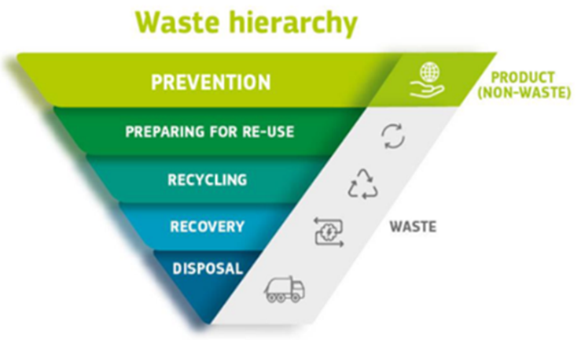
Lubricants and Greases End of Life Sustainable Best Practices
The Challenge
Lubricants degrade over time due to contamination, additive depletion, and oxidation.
Waste oil contains hazardous substances
Improper disposal = environmental & health risks.
Optimize waste oil handling to reduce environmental impact while boosting recovery, recycling, and reuse.
Circular Economy & Waste Hierarchy
Goal: Close the loop
Waste Hierarchy (EU Directive 2008/98/EC)
Key Tools & Concepts
10R Framework, from Refuse to Recover. Expand waste management options.
EPR (Extended Producer Responsibility), responsible end-of-life treatment.
LCA Studies, e.g. regeneration as sustainable waste oil treatment.
3.
4.
5.
6.
7.
8.
9.
10.
11.
12.
Sustainable Waste Management
Portfolio Strategy
Waste Reduction
Storage and Handling
Application Advice
Regulatory Compliance
EU Member State Data
Transparency
Packaging
Disposal

Slide 26
Lubricants and Greases End of Life Sustainable Best Practices
Key Challenges
High waste from single-use, non-recyclable packaging
Contamination and complex materials hinder recycling
Lack of infrastructure for reuse and take-back
Regulatory Drivers, e.g. EU PPWR (2025)
Mandatory recycled content (e.g. PCR plastic)
Design for recyclability
Reuse targets for drums/IBCs
Extended Producer Responsibility (EPR)
Examples of best practices for circularity
Design for Recycling: Simplify materials (e.g. 100% HDPE)
Use of Recycled Content: e.g. PCR, Lower carbon footprint
Closed-Loop Systems: Reuse drums/IBCs
Take-Back Programs: Collection & reconditioning
Shift to Larger Formats: Reduce packaging per liter
Data-Driven Design: Use LCA/PCF for decisions
Innovations: Biodegradable liners,refill systems
Ensure packaging is recyclable or reusable to support responsible disposal and circular solutions.
3.
4.
5.
6.
7.
8.
9.
10.
11.
12.
Sustainable Waste Management
Portfolio Strategy
Waste Reduction
Storage and Handling
Application Advice
Regulatory Compliance
EU Member State Data
Transparency
Packaging
Disposal

Slide 27
Lubricants and Greases End of Life Sustainable Best Practices
Extend product life and reduce waste by promoting optimal usage and maintenance practices.
Total Loss Lubricants:
Use EALs (biodegradable, low-toxicity) for applications like chains, gears, greases; partner with recyclers where possible.
Filled-for-Life Applications:
Design lubricants with minimal EoL impact; dispose via component recycling (steel/plastic pathways).
Application specific Best Practices:
Automotive/Industrial Oils: Extend life via monitoring, filtration, and optimized change intervals.
Hydraulic & Turbine Oils: Use filtration, oil analysis, and online monitoring.
Greases & Chain Oils: Promote use of certified EALs; prevent excess loss via maintenance.
Special Oils (e.g. Transformer, Compressor, Metalworking): Use targeted filtration & testing; segregate for recycling.
3.
4.
5.
6.
7.
8.
9.
10.
11.
12.
Sustainable Waste Management
Portfolio Strategy
Waste Reduction
Storage and Handling
Application Advice
Regulatory Compliance
EU Member State Data
Transparency
Packaging
Disposal

Slide 28
Lubricants and Greases End of Life Sustainable Best Practices
Develop products with lower end-of-life impacts through sustainable sourcing and circular design.
e.g. Ecodesign
3.
4.
5.
6.
7.
8.
9.
10.
11.
12.
Sustainable Waste Management
Portfolio Strategy
Waste Reduction
Storage and Handling
Application Advice
Regulatory Compliance
EU Member State Data
Transparency
Packaging
Disposal

Slide 29
Lubricants and Greases End of Life Sustainable Best Practices
Develop products with lower end-of-life impacts through sustainable sourcing and circular design.
Track the full product lifecycle to enable better end-of-life management and circularity monitoring.
e.g. ATIEL & UEIL Certified Methodology for PCF Calculations + PCF Calculation Tool
3.
4.
5.
6.
7.
8.
9.
10.
11.
12.
Sustainable Waste Management
Portfolio Strategy
Waste Reduction
Storage and Handling
Application Advice
Regulatory Compliance
EU Member State Data
Transparency
Packaging
Disposal

Slide 30
Lubricants and Greases End of Life Sustainable Best Practices
Develop products with lower end-of-life impacts through sustainable sourcing and circular design.
Track the full product lifecycle to enable better end-of-life management and circularity monitoring.
Minimize waste throughout the lifecycle by improving tracking and encouraging reduction strategies.
3.
4.
5.
6.
7.
8.
9.
10.
11.
12.
Sustainable Waste Management
Portfolio Strategy
Waste Reduction
Storage and Handling
Application Advice
Regulatory Compliance
EU Member State Data
Transparency
Packaging
Disposal

Slide 31
Lubricants and Greases End of Life Sustainable Best Practices
Preserve product quality and extend useful life (reduce waste) by optimizing storage and handling practices.
Develop products with lower end-of-life impacts through sustainable sourcing and circular design.
Track the full product lifecycle to enable better end-of-life management and circularity monitoring.
Minimize waste throughout the lifecycle by improving tracking and encouraging reduction strategies.
3.
4.
5.
6.
7.
8.
9.
10.
11.
12.
Sustainable Waste Management
Portfolio Strategy
Waste Reduction
Storage and Handling
Application Advice
Regulatory Compliance
EU Member State Data
Transparency
Packaging
Disposal

Slide 32
Lubricants and Greases End of Life Sustainable Best Practices
Preserve product quality and extend useful life by optimizing storage and handling practices.
Develop products with lower end-of-life impacts through sustainable sourcing and circular design.
Promote safe collection and disposal while integrating recycling into circular systems.
Track the full product lifecycle to enable better end-of-life management and circularity monitoring.
Minimize waste throughout the lifecycle by improving tracking and encouraging reduction strategies.
3.
4.
5.
6.
7.
8.
9.
10.
11.
12.
Sustainable Waste Management
Portfolio Strategy
Waste Reduction
Storage and Handling
Application Advice
Regulatory Compliance
EU Member State Data
Transparency
Packaging
Disposal

Slide 33
Lubricants and Greases End of Life Sustainable Best Practices
Preserve product quality and extend useful life by optimizing storage and handling practices.
Develop products with lower end-of-life impacts through sustainable sourcing and circular design.
Promote safe collection and disposal while integrating recycling into circular systems.
Track the full product lifecycle to enable better end-of-life management and circularity monitoring.
Comply with laws while supporting circularity goals through responsible product handling.
Minimize waste throughout the lifecycle by improving tracking and encouraging reduction strategies.
3.
4.
5.
6.
7.
8.
9.
10.
11.
12.
Sustainable Waste Management
Portfolio Strategy
Waste Reduction
Storage and Handling
Application Advice
Regulatory Compliance
EU Member State Data
Transparency
Packaging
Disposal

Slide 34
Lubricants and Greases End of Life Sustainable Best Practices
Preserve product quality and extend useful life by optimizing storage and handling practices.
Develop products with lower end-of-life impacts through sustainable sourcing and circular design.
Promote safe collection and disposal while integrating recycling into circular systems.
Track the full product lifecycle to enable better end-of-life management and circularity monitoring.
Comply with laws while supporting circularity goals through responsible product handling.
Use national insights to align end-of-life practices with circular economy objectives.
Minimize waste throughout the lifecycle by improving tracking and encouraging reduction strategies.
3.
4.
5.
6.
7.
8.
9.
10.
11.
12.
Sustainable Waste Management
Portfolio Strategy
Waste Reduction
Storage and Handling
Application Advice
Regulatory Compliance
EU Member State Data
Transparency
Packaging
Disposal

Slide 35

Lubricants and Greases End of Life
Thank you for your attention!
Feel free to scan the QR code now to explore the full document.

Slide 36
Circular Materials Working Group

Slide 37

Establishment of Circular Materials Group
The group will support the lubricants industry by focusing on key aspects of circularity such as:
The use of re-refined base oils (RRBO) and other circular or renewable materials in lubricants
Identifying updates in European legislation impacting circular materials and their use in lubricants
Creating shared positions, best practice and guidance, as well as considering circular materials within general application frameworks and how they are treated with respect to life-cycle assessment (LCA) methodologies and circularity.
Notes:
Realm of sustainability and impact o nlubricants industry. JSC answering specific needs of lubricants industry.
Work with global associations.
Regulatory drivers in Europe.
The group will support the lubricants industry by focusing on key aspects of circularity such as:
The use of re-refined base oils (RRBO) and other circular or renewable materials in lubricants
identifying updates in European legislation impacting circular materials and their use in lubricants,
creating shared positions, best practice and guidance, as well as considering circular materials within general application frameworks and how they are treated with respect to life-cycle assessment (LCA) methodologies and circularity.

Slide 39
Overview
Why collaboration is essential
What collaboration can achieve

